Slide 1
Lesson 5: String Slicing
Mack 2023
Notes:
Last updated: 6/14/2023

Slide 2
Warm Up

Slide 3
Make a prediction
Starter activity
1 2 3 4 5 6 7 8 | word = "beach" count = 0 for letter in word: if letter > "c": count = count + 1 print(count)
Questions .
What will be the output of print, when this program is executed?
2
5
You cannot use > with a string, this would cause an error
count
▹
1
2
3
4
Why? .
The > symbol checks if the letter is later in the dictionary than c. All of the letters in beach are, so the output is 5.

Slide 4

Lesson 27: String handling II
Objectives
In this lesson, you will:
Use a substring in a program
Use the in operator to check for a substring
Use chr() and ord() to perform ASCII conversions

Slide 5
Activity 1

Slide 6
Substring
Activity 1
A substring is a part of a string.
In Python, you use the slice tool to retrieve a substring.
Question .
What do you think will be the output of print when this program is executed?
word = "HELLO"
first_two = word[0:2]
print(first_two)
>>
HE

Slide 7
Substring
Activity 1
The slice tool accesses the substring based on the index location of the characters.
word = "HELLO"

Slide 8
Substring
Activity 1
The index begins at 0.
01234
word = "HELLO"

Slide 9
Substring
Activity 1
The first number is where you wish to start the substring.
01234
word = "HELLO"
first_two = word[0:2]

Slide 10
Substring
Activity 1
The second number is the stopping point.
Just like with range(0,5). It goes up to 5, but doesn’t include it.
01234
word = "HELLO"
first_two = word[0:2]

Slide 11
Substring
Activity 1
This means that word[0:2] generates a new string with the letters HE from the substring.
01234
word = "HELLO"
first_two = word[0:2]

Slide 12
Substring
Activity 1
Question .
What do you think will be the output of print when this program is executed?
01234
word = "HELLO"
substring = word[1:4]
print(substring)
>>
ELL

Slide 13
Substring
Activity 1
You can also check if a word contains a specified substring using the in operator.
word = "hello"
if "he" in word:
print("Found!")

Slide 14
Substring
Activity 1
Question .
What do you think will be the output of print when this program is executed?
username = "12FranksR"
if "12" in username:
print("Valid username")
else:
print("Username not valid")
>>
Valid username

Slide 15
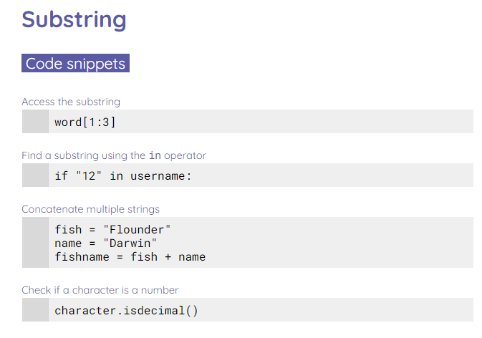
Substring
Activity 1
Complete the worksheet to practise using substring in programs.

Slide 16
Activity 2

Slide 17
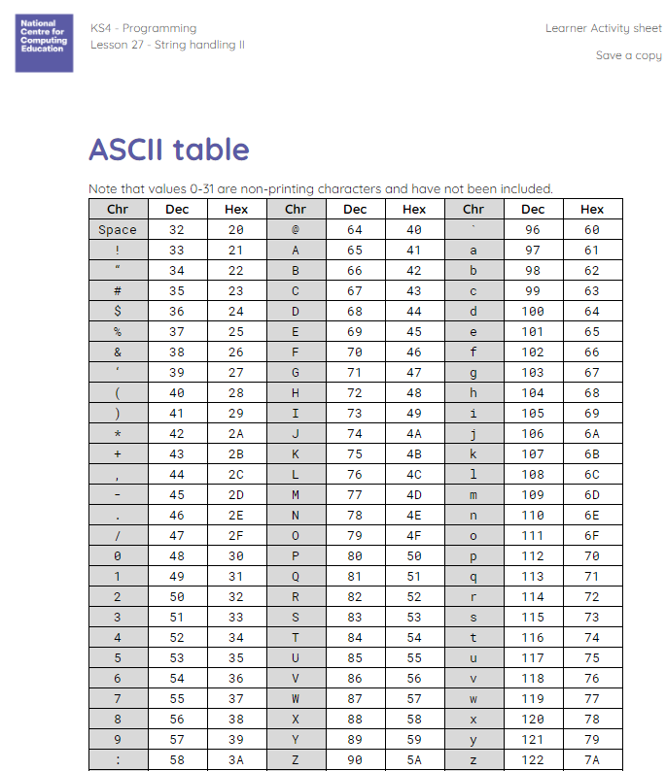
Performing ASCII conversions
Activity 2
ASCII is a character set used to represent all of the characters on a standard American or English keyboard.
Each character has a unique code. You can find the codes by looking at an ASCII table.

Slide 18
Performing ASCII conversions
Activity 2
For each character in the table, the decimal code increases by one.
Question .
What will the decimal and hex values of D be?
Chr | Dec | Hex
A | 65 | 41
B | 66 | 42
C | 67 | 43

Slide 19
Performing ASCII conversions
Activity 2
For each character in the table, the decimal code increases by one.
Question .
What will the decimal and hex values of D be?
Chr | Dec | Hex
A | 65 | 41
B | 66 | 42
C | 67 | 43
D | 68 | 44

Slide 20
Performing ASCII conversions
Activity 2
Python has two functions that perform ASCII conversions:
chr(97)
This takes an decimal number and returns its character equivalent.
ord("a")
This takes a character and returns its decimal equivalent.

Slide 21
Performing ASCII conversions
Activity 2
Question .
What do you think will be the output when this program is executed?
1 2 3 4 5 | character = "A" print(ord(character)) decimal = 66 print(chr(decimal))
 | >>> 65 B

Slide 22
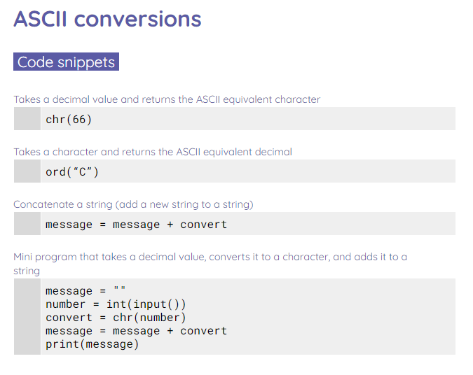
Performing ASCII conversions
Activity 2
Complete the worksheet to try out some ASCII conversions.

Slide 23
Activity 3

Slide 24
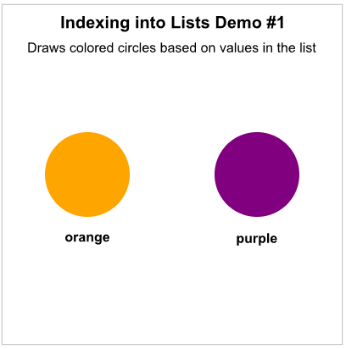
Lists
Activity 3
Read through the List section!

Slide 25
Wrap Up

Slide 26
Make a prediction
Wrap Up
1 2 3 | word = "fish" sub = word[1:3] print(sub)
Questions .
What will be the output of print, when this program is executed?
is
fis
sub
An error will occur
▹
1
2
3
4
Why? .
[1:3] takes a substring using the second value as the starting value, and the last value as the stopping point.

Slide 27
Make a prediction
Wrap Up
1 2 3 4 5 6 7 8 | word = "ABC" coded_word = "" for letter in word: convert = ord(letter) coded_word = coded_word + str(convert) print(coded_word)
Questions .
What will be the output of print, when this program is executed?
65 66 67
65, 66, 67
656667
coded_word
1
2
▹
3
4
Why? .
A comma or space has not been added to the string, so all of the numbers will be together.

Slide 28
Next lesson
Summary
In this lesson, you…
Learnt how to use substring and perform ASCII conversions.
Next lesson, you will…
Complete a series of string-handling challenges.

